Slide 1
Welcome to the Swedish Defence University

Slide 2
Agenda
Welcome to SEDU – Malena Britz (Pro-Vice-Chancellor) and Kjell Engelbrekt (Dean)
Joint activities/The field of defence, crisis management and security – Kjell Engelbrekt (Dean)
General information about SEDU (PhDhandbook, regulations etc.) – Birgitta Mattsson
General information about employment etc. – HR/ Camilla Sävmarker, Catarina Heed
Coffee
Equal treatment and harassment – Shirin Mattisson
Grants Office – Olov Wenell
Anna Lindh Library – Joakim Andersson
PhD section of students’ union – Moa Peldán
Lunch, wraps in Mässen
Tour of the buildings with the PhD section of students’ union

Slide 3
Birgitta.Mattsson@fhs.se
Coordinator for Doctoral Education
Rules an regulations
Support the subject with admitting PhD students
Economy and planning of the PhD programme
Administraive contact for PhD students

Slide 4
About SEDU
2000 students
900 officers in the Swedish Armed Forces.
Since 1818
Part of the regular Swedish university system since 2008
The first group of PhD students admitted at SEDU started 2019
49 PhD students
450 employees

Slide 5
Organisation
The field: Defence, crisis management, and security
Degree-awarding powers for doctoral degrees in three subjects:
War Studies
Political science with a specialization in crisis management and security studies
Military History
Every subject has a director of studies for doctoral education

Slide 6
Subjects
Leadership and Command & Control
Systems Science for Defence and Security
International Law

Slide 7
Regulations
The Higher Education Ordinance (Högskoleförordningen) regulates all levels of university education
The SEDU rules are based on these
All rules and regulations can be found in the doctoral student handbook
Not all are yet translated to English

Slide 8
The Higher Education Ordinance
The Higher Education Ordinance states that:
A person appointed to doctoral studentship must primarily dedicate time to their own studies (chapter 5, section 2)
A doctoral student is both an employee and a student

Slide 9
Education
4 years + totally 1 year departmental duties (institutionstjänstgöring)
Special grounds for prolongation:
leave of absence because of illness
service in the Swedish armed forces
an elected position in a trade union or student organization
parental leave

Slide 10
Departmental duties
Departmental duties must be designed so that it is relevant to the doctoral student’s education
The duties must not have an unfavourable impact on the doctoral programme.
May include:
Teaching, including seminars, at undergraduate and graduate level
Supervision of theses at undergraduate and graduate level
Organisation of higher seminar series
Organising workshops, conferences
Administration

Slide 11
General Syllabus for PhD studies
In Swedish: Allmän studieplan, ASP
Each subject has its own
Regulates the content of the programme
Describes compulsory courses
What the doctoral student is expected to learn
What applies at the defence of the doctoral thesis etc.

Slide 12
Individual study plan
Plan for the entire programme
To be monitored and , when needed, revised annually
The doctoral student develops it together with their supervisor
The doctoral students can ensure that they get the education they are entitled to
The supervisor and director of studies can follow up that all elements have been completed
Currently on paper

Slide 13
Intranet
SEDU Intranet in English ”My SEDU”
In Swedish ”Mitt FHS”
The English version is just published
The PhD handbook
Sweden’s United Student Unions (Sveriges Förenade Studentkårer, SFS) https://phdhandbook.se/

Slide 14
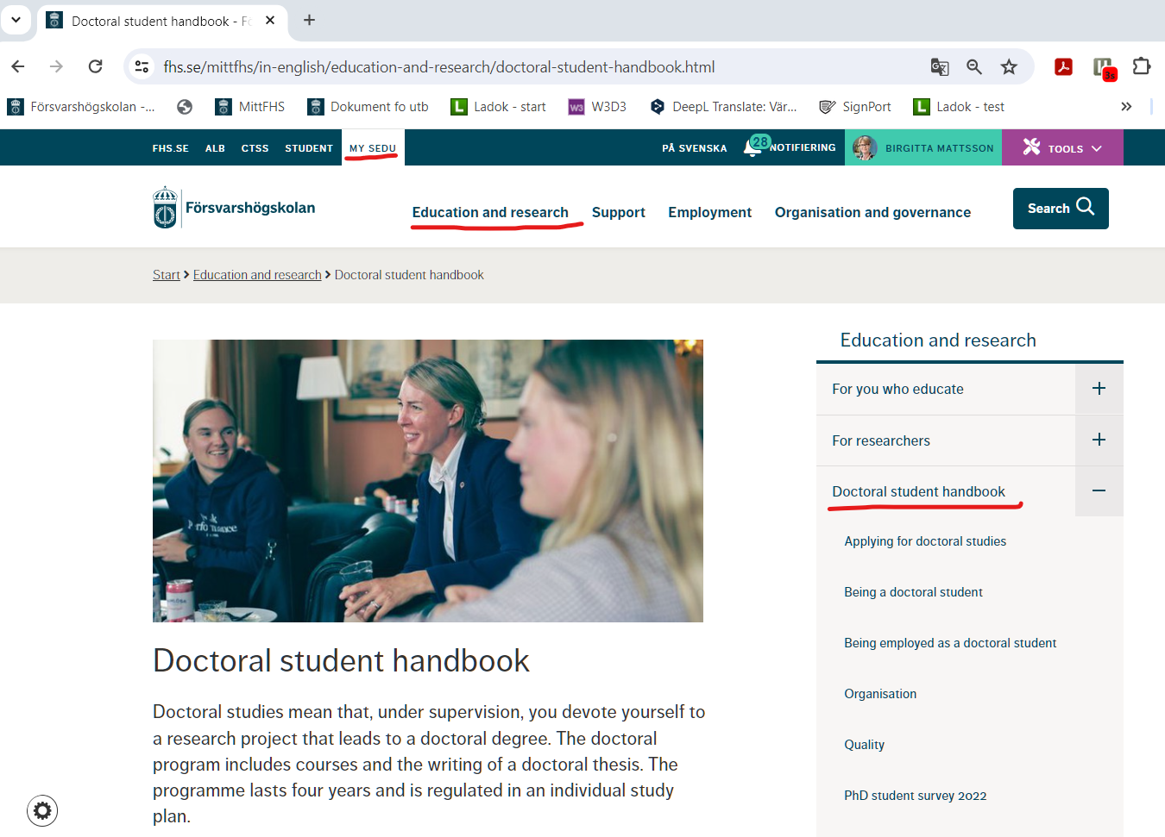

Slide 15
LADOK
Administrative system for Swedish universities
This is where all courses etc. are registered

