Slide 1
The financiers’ toolbox – your toolbox
Career development
Research and innovation projects
Internationa-lisation and networking
Collaboration and exchange
Recruitment
Build and develop research environment
Notes:
E Namnet på workshopen? Finansiärerna och deras uppdrag > deras instrument för att uppnå sina (myndighets) uppdrag. Exempel VR, Forte Horizon osv ”politiska instrument” –andra privata stiftelser osv har även de specifika syften
Varför finns det olika/flera finansiärer? Olika fokus, policybakgrund osv ex

Slide 2
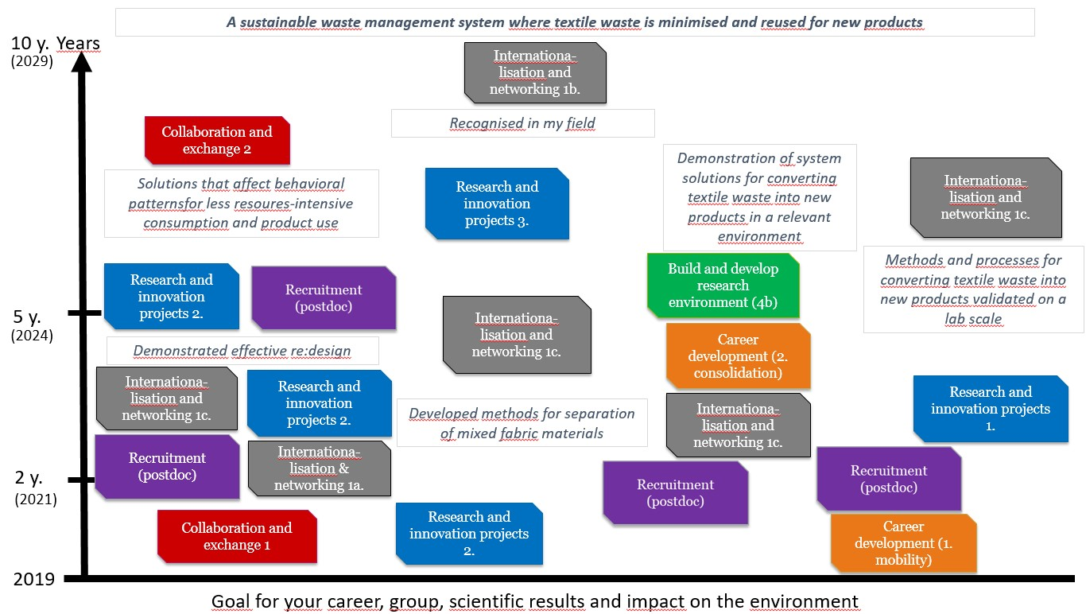
Exampel of a research funding strategy (Borås University).
Notes:
E

Slide 3
Career development
Postdoc (junior grant): MSCA, VR, Forte, Formas, KK Prospekt, Formas Mobility Support, Pro Futura RJ/SCAS, Wallenberg Academy Fellow
Establishment grant: VR, ERC Starting Grant (RJ - Swedish Foundations’ Starting Grant), Novo Nordisk Foundation Emerging Investigator
Future research leaders: Swedish foundation for strategic research (SSF), ERC Starting Grant
Consolidation grant: VR, ERC Consolidator Grant, Novo Nordisk Foundation Ascending Investigator
Well-established researchers: ERC Advanced Grant, Novo Nordisk Foundation Distinguished Investigator, The Wallenberg Foundation (KAW, MMW), VR Council Professor
Notes:
E: Poäng: target is researchers at a specific career stage early - > established

Slide 4
Career development
Emerging Investigator grant 5 years (NNF)
Research projects for early-career researchers 4 years (Formas)
0 1 2 3 4 5 6 7 8 9 10 11 12
Eligibility criteria: Years after PhD graduate / career age
Future Research Leaders 5 years (SSF)
Pro Futura 5 years (RJ)
Establishment grant 4-5 years (VR & ERC)
Wallenberg 3-5 years (KAW, MMW)
Starting grant 5 years (ERC/RJ)
Synergy grant 6 years (ERC)
Mobility grant 2-4 years (Formas)
Advanced grant 5 years (ERC)
Postdoc 2-3 years (MSCA, KK Prospect)
Consolidation grant 5-6 years (VR, ERC)
Postdoc 1-3 years (VR, Forte, MSCA)
Ascending Investigator grant 5 years (NNF)
Notes:
EE. Exempel på hur din plan kan se ut mha career dev grants

Slide 5
Research and innovation projects
1. Pure research/bottom-up projects:
VR, Formas, Forte, RJ, SSF, ERC Synergy Grant, entire HEU pillar 1 (basic research), etc.
2. Research project in co-production / collaboration:
KK HÖG, Formas, HEU Research and Innovation Actions (mainly pillar 2), Swedish Energy Agency, Mistra, etc.
3. Innovation project:
Vinnova ( UDI – Challenge-driven innovation , Circular & Bio-based economics), Formas, Swedish Energy Agency, HEU Innovation Actions (mainly pillar 2), European Innovation Council (EIC) Pathfinder etc.
Notes:
O The most common and popular kind of funding. Based on an idea of a typical and efficient format for solving a research question.

Slide 6
Internationa-lisation and networking
1. Internationalisation
a) Guest professor: VR, Forte, KK-stiftelsen, Wenner-Gren
b) Mobility allowance / Stay allowance: SSF, STINT, (Formas Mobility allowance)
c) Conference allowance: VR, Forte, RJ
2. Network grants
• Establish networks, often interdisciplinary and cross-sectoral
• The networks may well be international
• In addition to creating networks per se , the focus can also be on:
- Take note of the latest research findings in the field
- Utilization of research
• COST Action (European Cooperation in Science and Technology), MSCA Staff Exchanges (HEU), Forte Network grant, VR Network Grant
Notes:
O Why do financiers have internationalisation grants, networking grants? Internationalisation drives quality development. You need to get to know colleagues before starting to really collaborate consortium formation step 1…

Slide 7
Collaboration and exchange
1. Inter-sectorial & Cross-industry mobility / Individual mobility:
Vinnova Individual Mobility, SSF Strategic Mobility, RJ Flexit
2. Communication project:
RJ, Formas, HEU CSA (Coordination and Support Actions)
3. Regional Development & Collaboration in Research and Innovation:
ERDF, Interreg, Vinnova UDI (Challenge-driven innovation), Vinnova Competens center
Notes:
O Partly overlaps with the previous one, but emphasis on co-production of research and education and knowledge transfer

