Slide 1
The Anna Lindh-Library, Research Support Services
Joakim Andersson
Librarian

Slide 2
Practical information
FHS-account/ institutional email adress
Library account

Slide 3
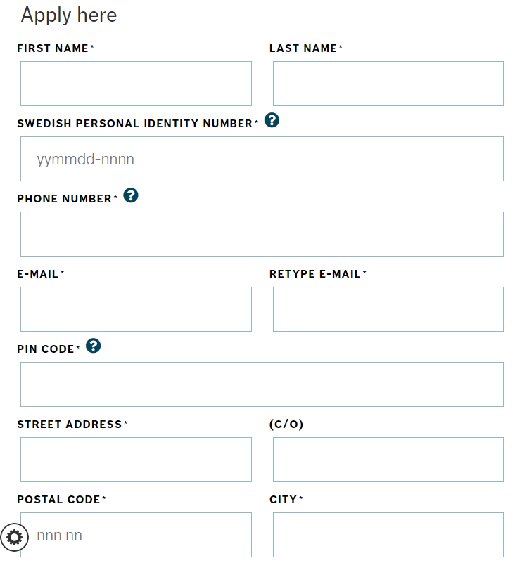

Slide 4
Research support at Anna Lindh-library
Information search or “retrieval process”
- Systematic information retrieval guidance
- Scoping studies
- Specific databases
- A.I. helpsystems
Reference Management Support
- EndNote
Data Management Support
- DAU

Slide 5
Research support at Anna Lindh-library
Scholarly Publishing and -Communication
- Strategic Publishing
- OA - Funding
- DiVA
Thesis and Report Series
- Templates
- Publication

Slide 6
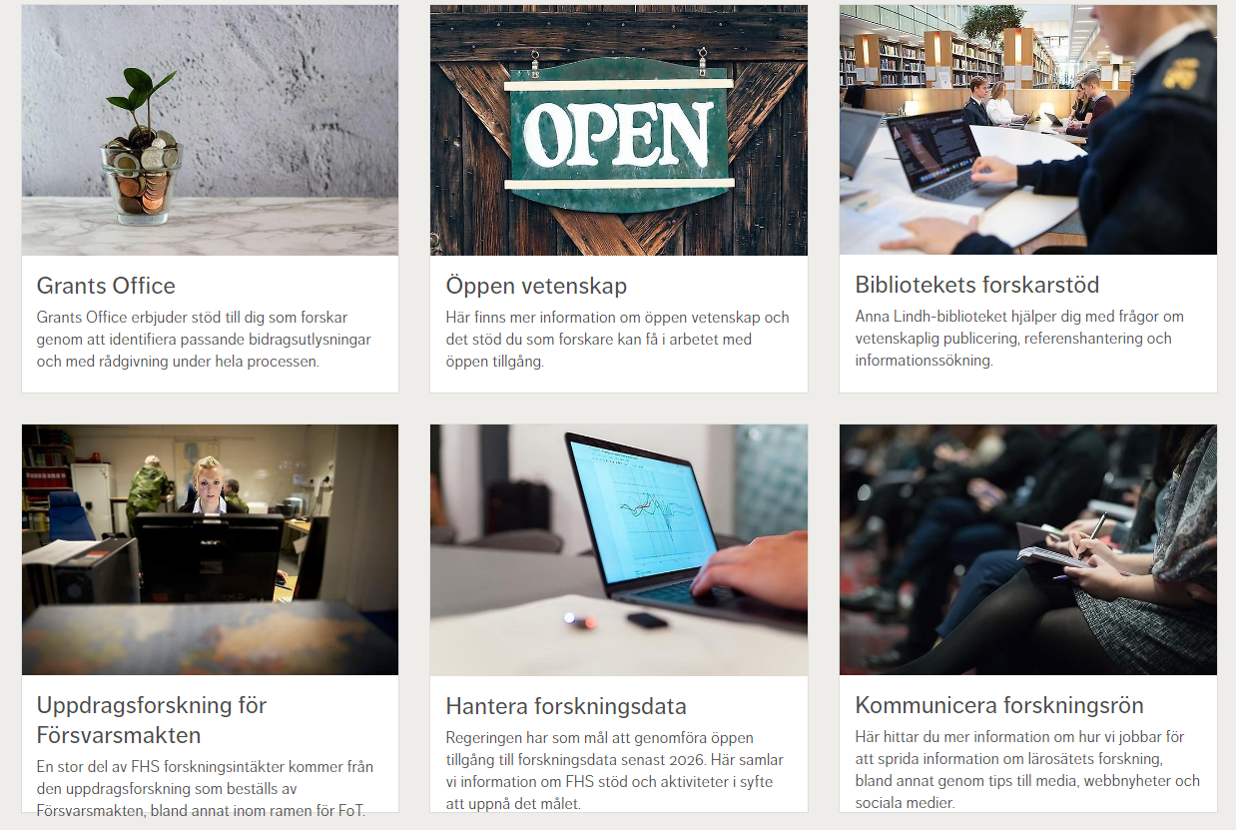
Research support at Anna Lindh-library
Johanna Lundström
Olof Frank
Jonny Trinh
Joakim Andersson
alb@fhs.se
fhs.se/anna-lindh-biblioteket

Slide 7
PHD seminar at the library
8th of February
2pm - 3pm
Room: Landquist

